Slide 1


Slide 2
Slide for video

Slide 3

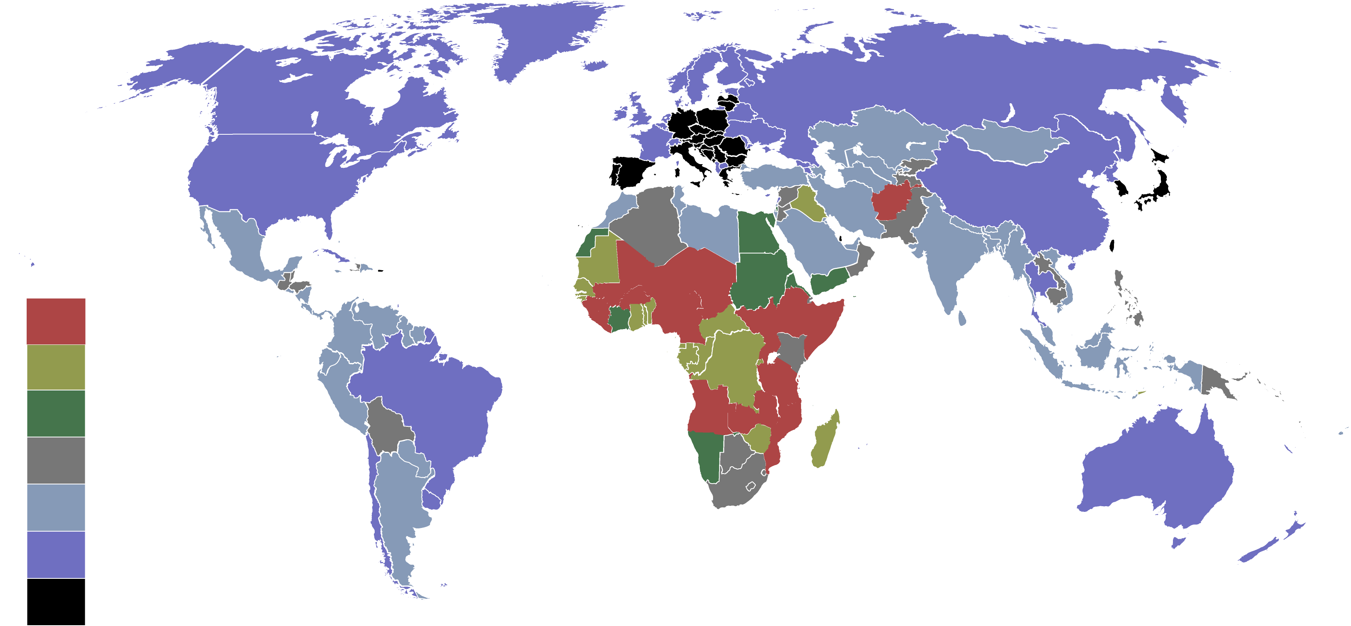
Countries by birth rate in 2017

Slide 4

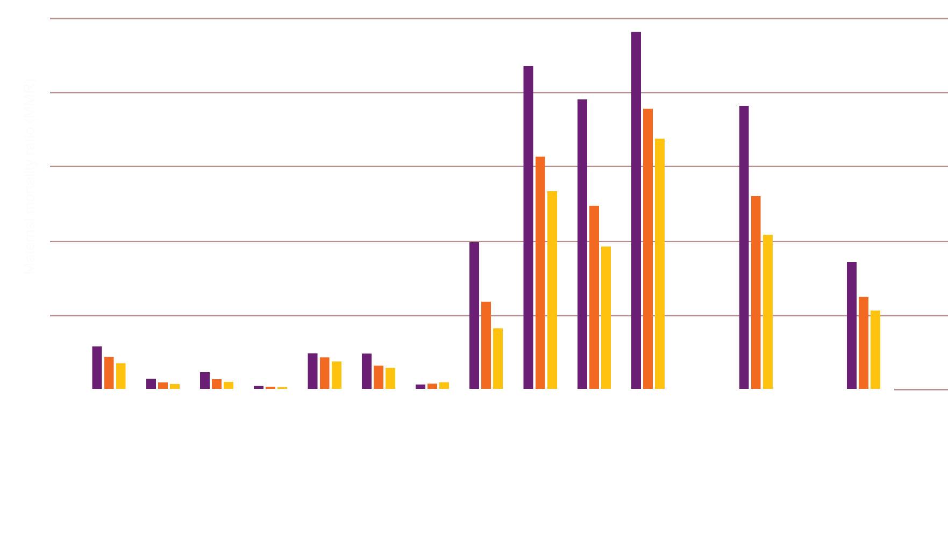
Maternal Mortality ratio
2000
2010
2017

Slide 5

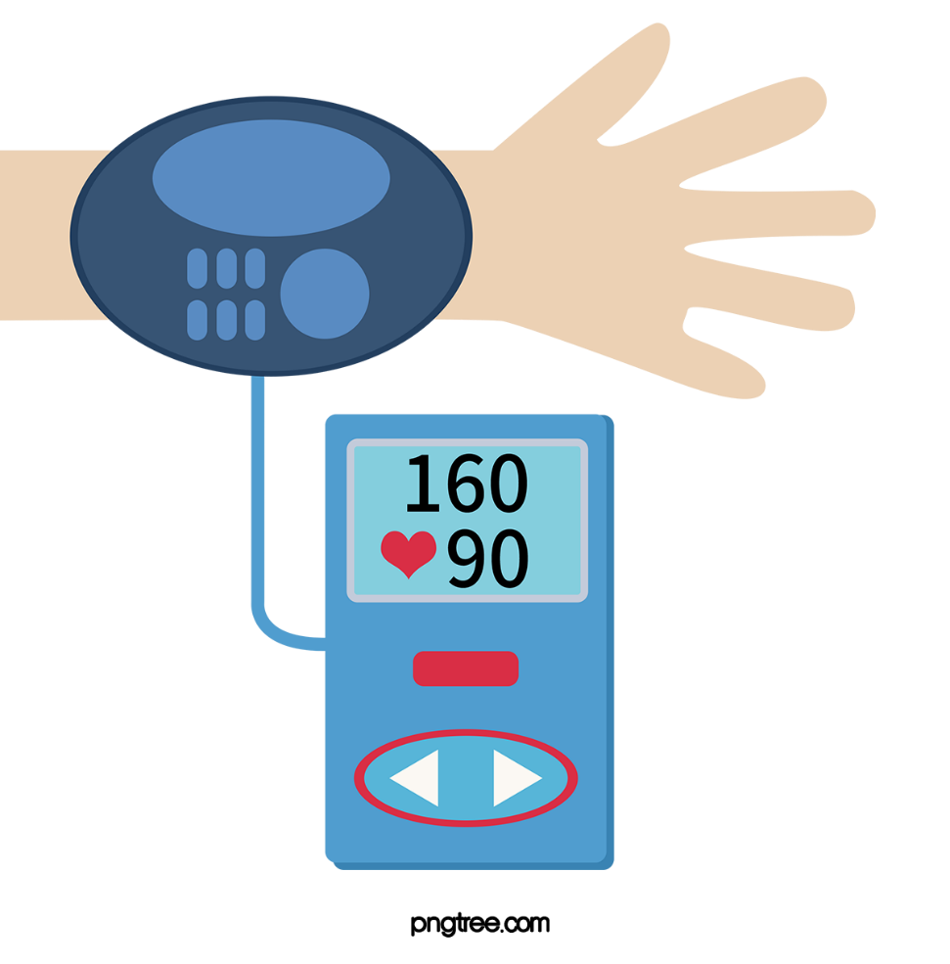
Problems
Scheduled Monitoring of body temperature, bpm and blood pressure could not be done.

Slide 6
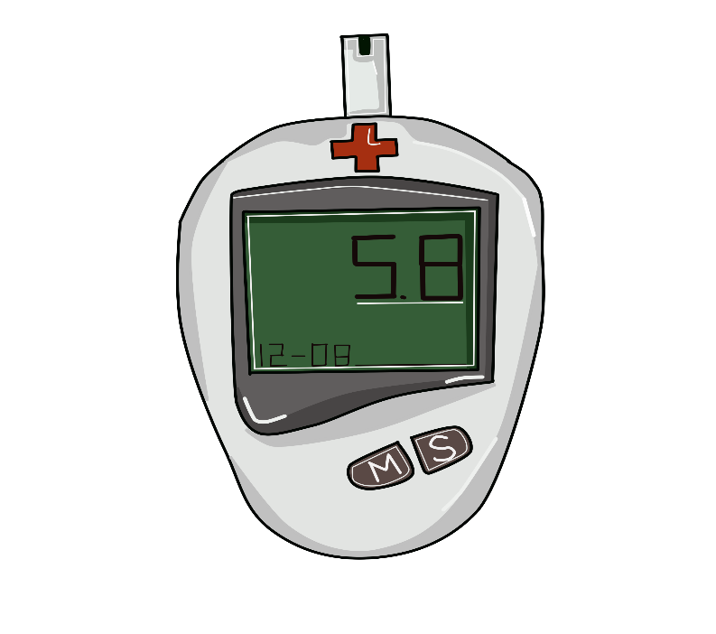
Lack of proper monitoring of glucose level can hamper a pregnant woman and her child.

Slide 7

Medicine specially anti biotics need to take in proper time. If it does not than it could develop anti resistant for a disease.

Slide 8

Proper nutrition taking is a must for pregnant woman and her child's health.

Slide 9





Steps we need to take
Continuous monitoring of temperature
Scheduled monitoring of glucose level
Scheduled monitoring of bpm and blood pressure
Maintaining schedule for medicine
Emergency service

Slide 10


Slide 11



Slide 12
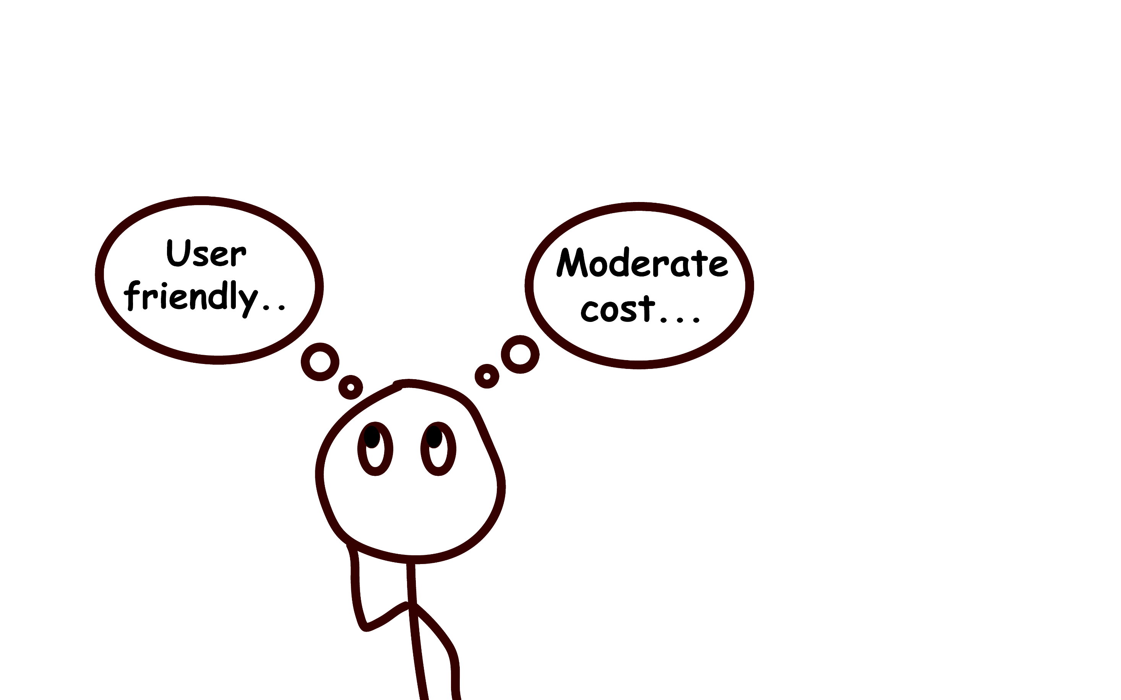


Slide 13
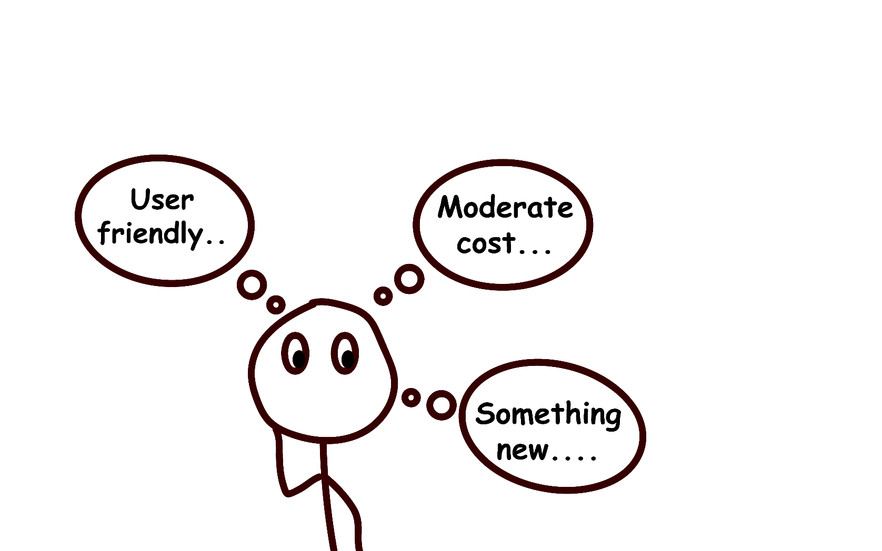


Slide 14
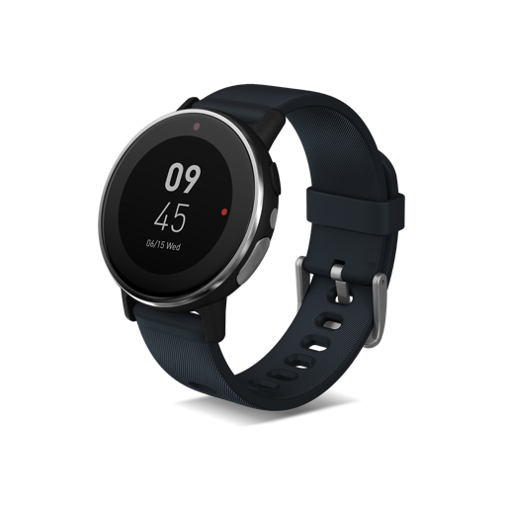
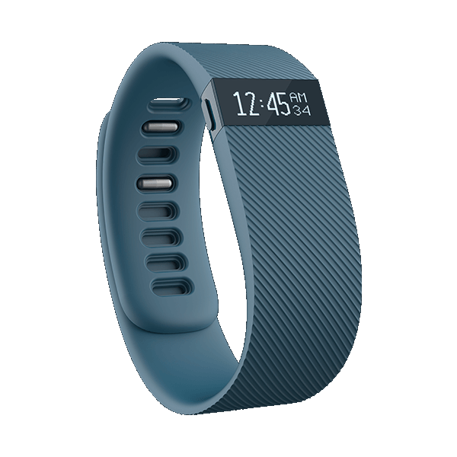
FitBit Charge
Price: 23,000 BDT
Acer Leap Ware
Price: 16,200 BDT

Slide 15
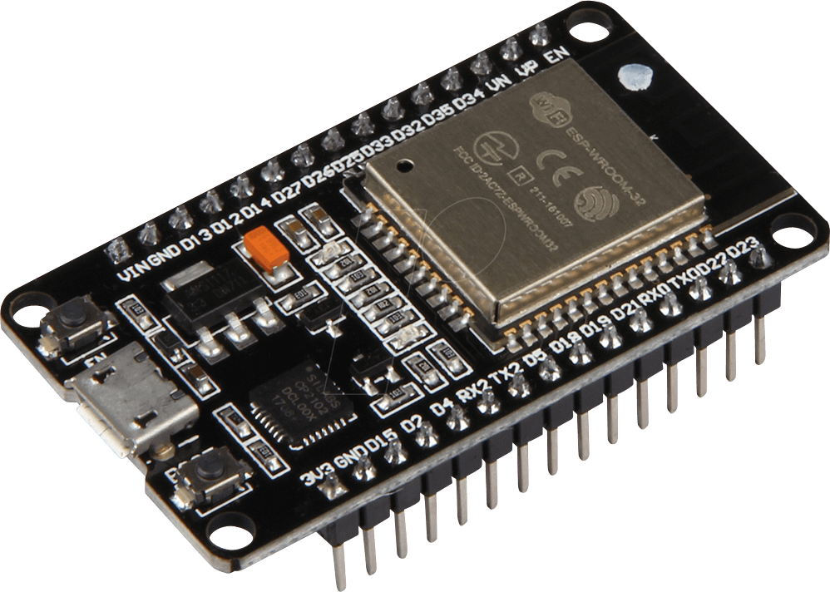

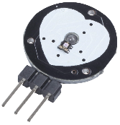
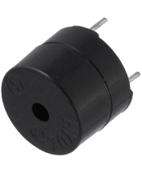
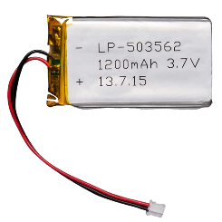
Components
ESP 32
Co sensor
Pulse sensor
Buzzer
Lipo 1200 mAh

Slide 16
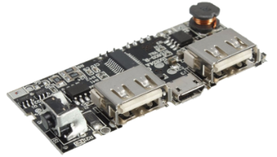
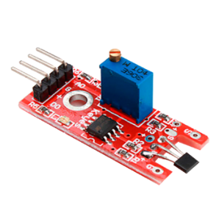


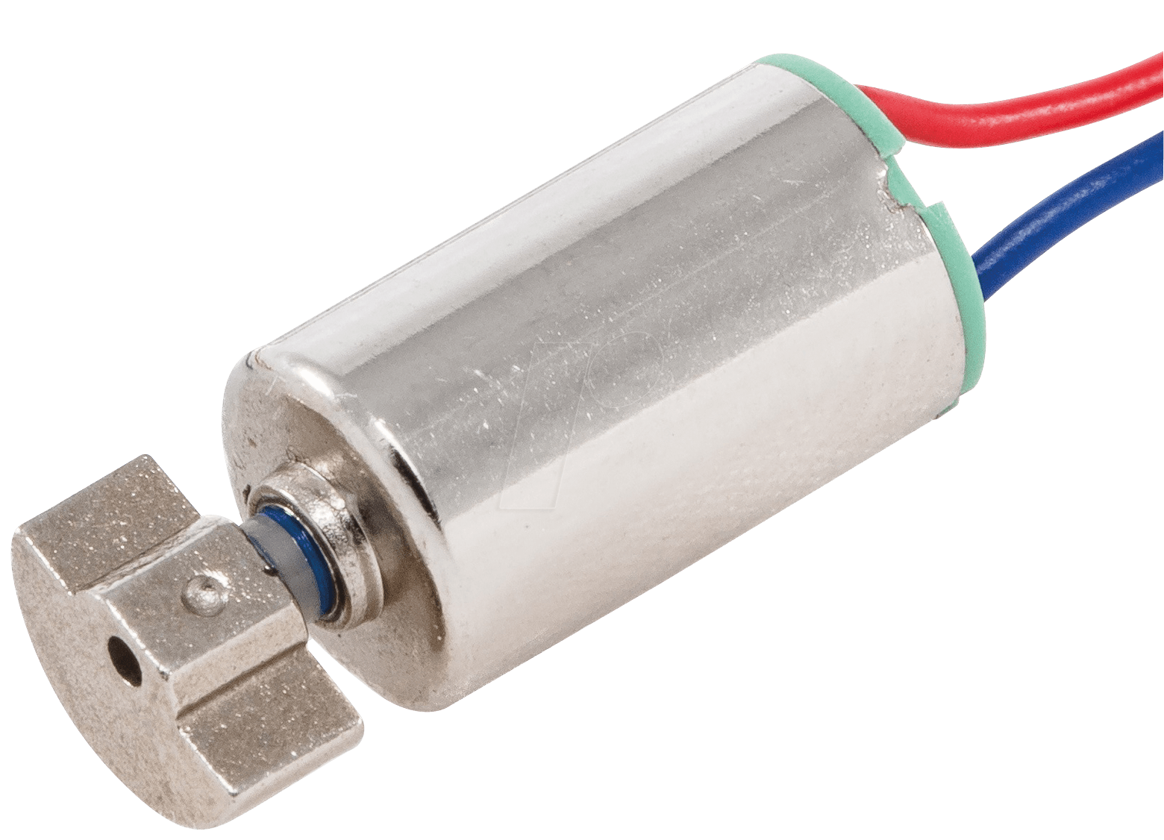

Integrated power bank circuit
Internally built in hall effect sensor
Temperature sensor LM35
Built in Bluetooth
Vibrator
Special switches

